Slide 1
HomeHub
Phase II
Team 5: Jiaxin He, Yan Huang, Sha Liu

Slide 2
The First 50% We’ve done
Two types of roles: customer/manger, different functionalities
Customer
Create customer account (in MySQL)
View services, book services, cancel services (in MySQL)
View products, purchase products (in MySQL)
Send out messages (in MySQL)
Modify user_profile
Manager
Create manager account (in MySQL)
View products, modify products (in MySQL)
View orders, modify orders (in MySQL)

Slide 3
The other 50% We expect
Nosql for review uploading
Map - recommended local service based on zip code
Graph database
Trending
Managerhome
Product sales data
Message/Email back to customer

Slide 4

Screenshot 1:
Tools shop:
All product stored in MySQL
Manager is able to add/delete/edit product
Place your screenshot here

Slide 5
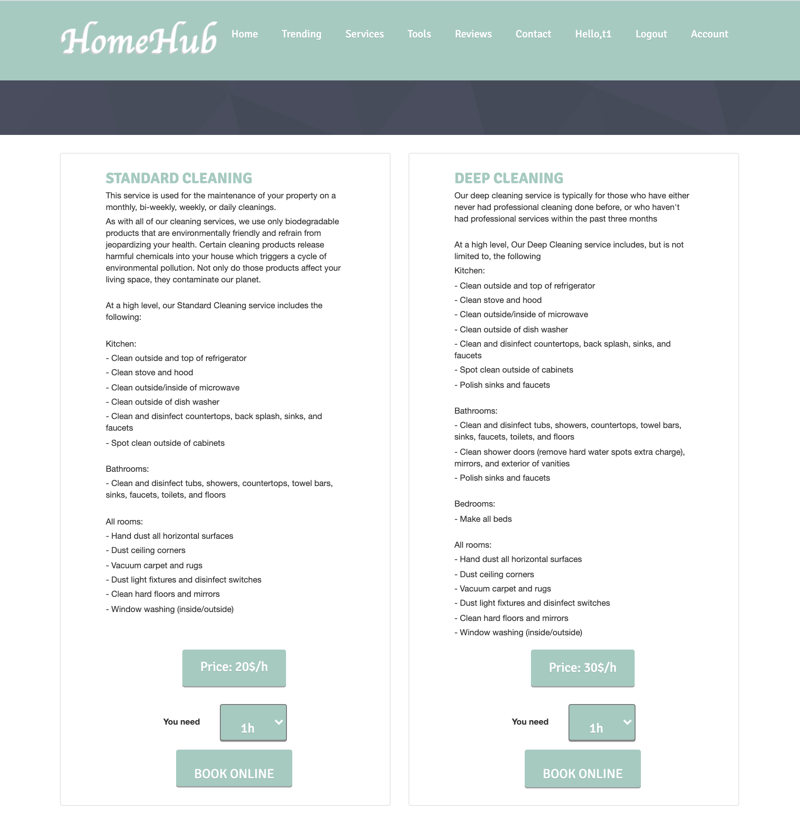
Screenshot 2:
Service:
Offers 12 kinds of specific services
Customer routing:
home->get quote->book online
Service orders stored in MySQL, Manager is able to add/delete/modify Service orders
Place your screenshot here

Slide 6
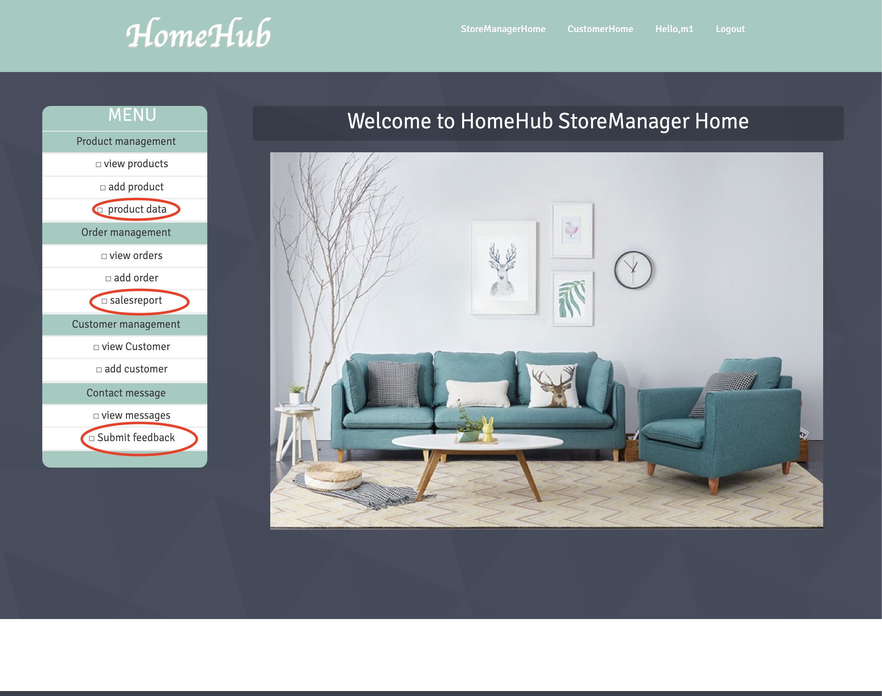
To-Do
Enhancing Analyzing module in manager home
Trending feature for customer
Enable reviews feature
Place your screenshot here

Slide 7
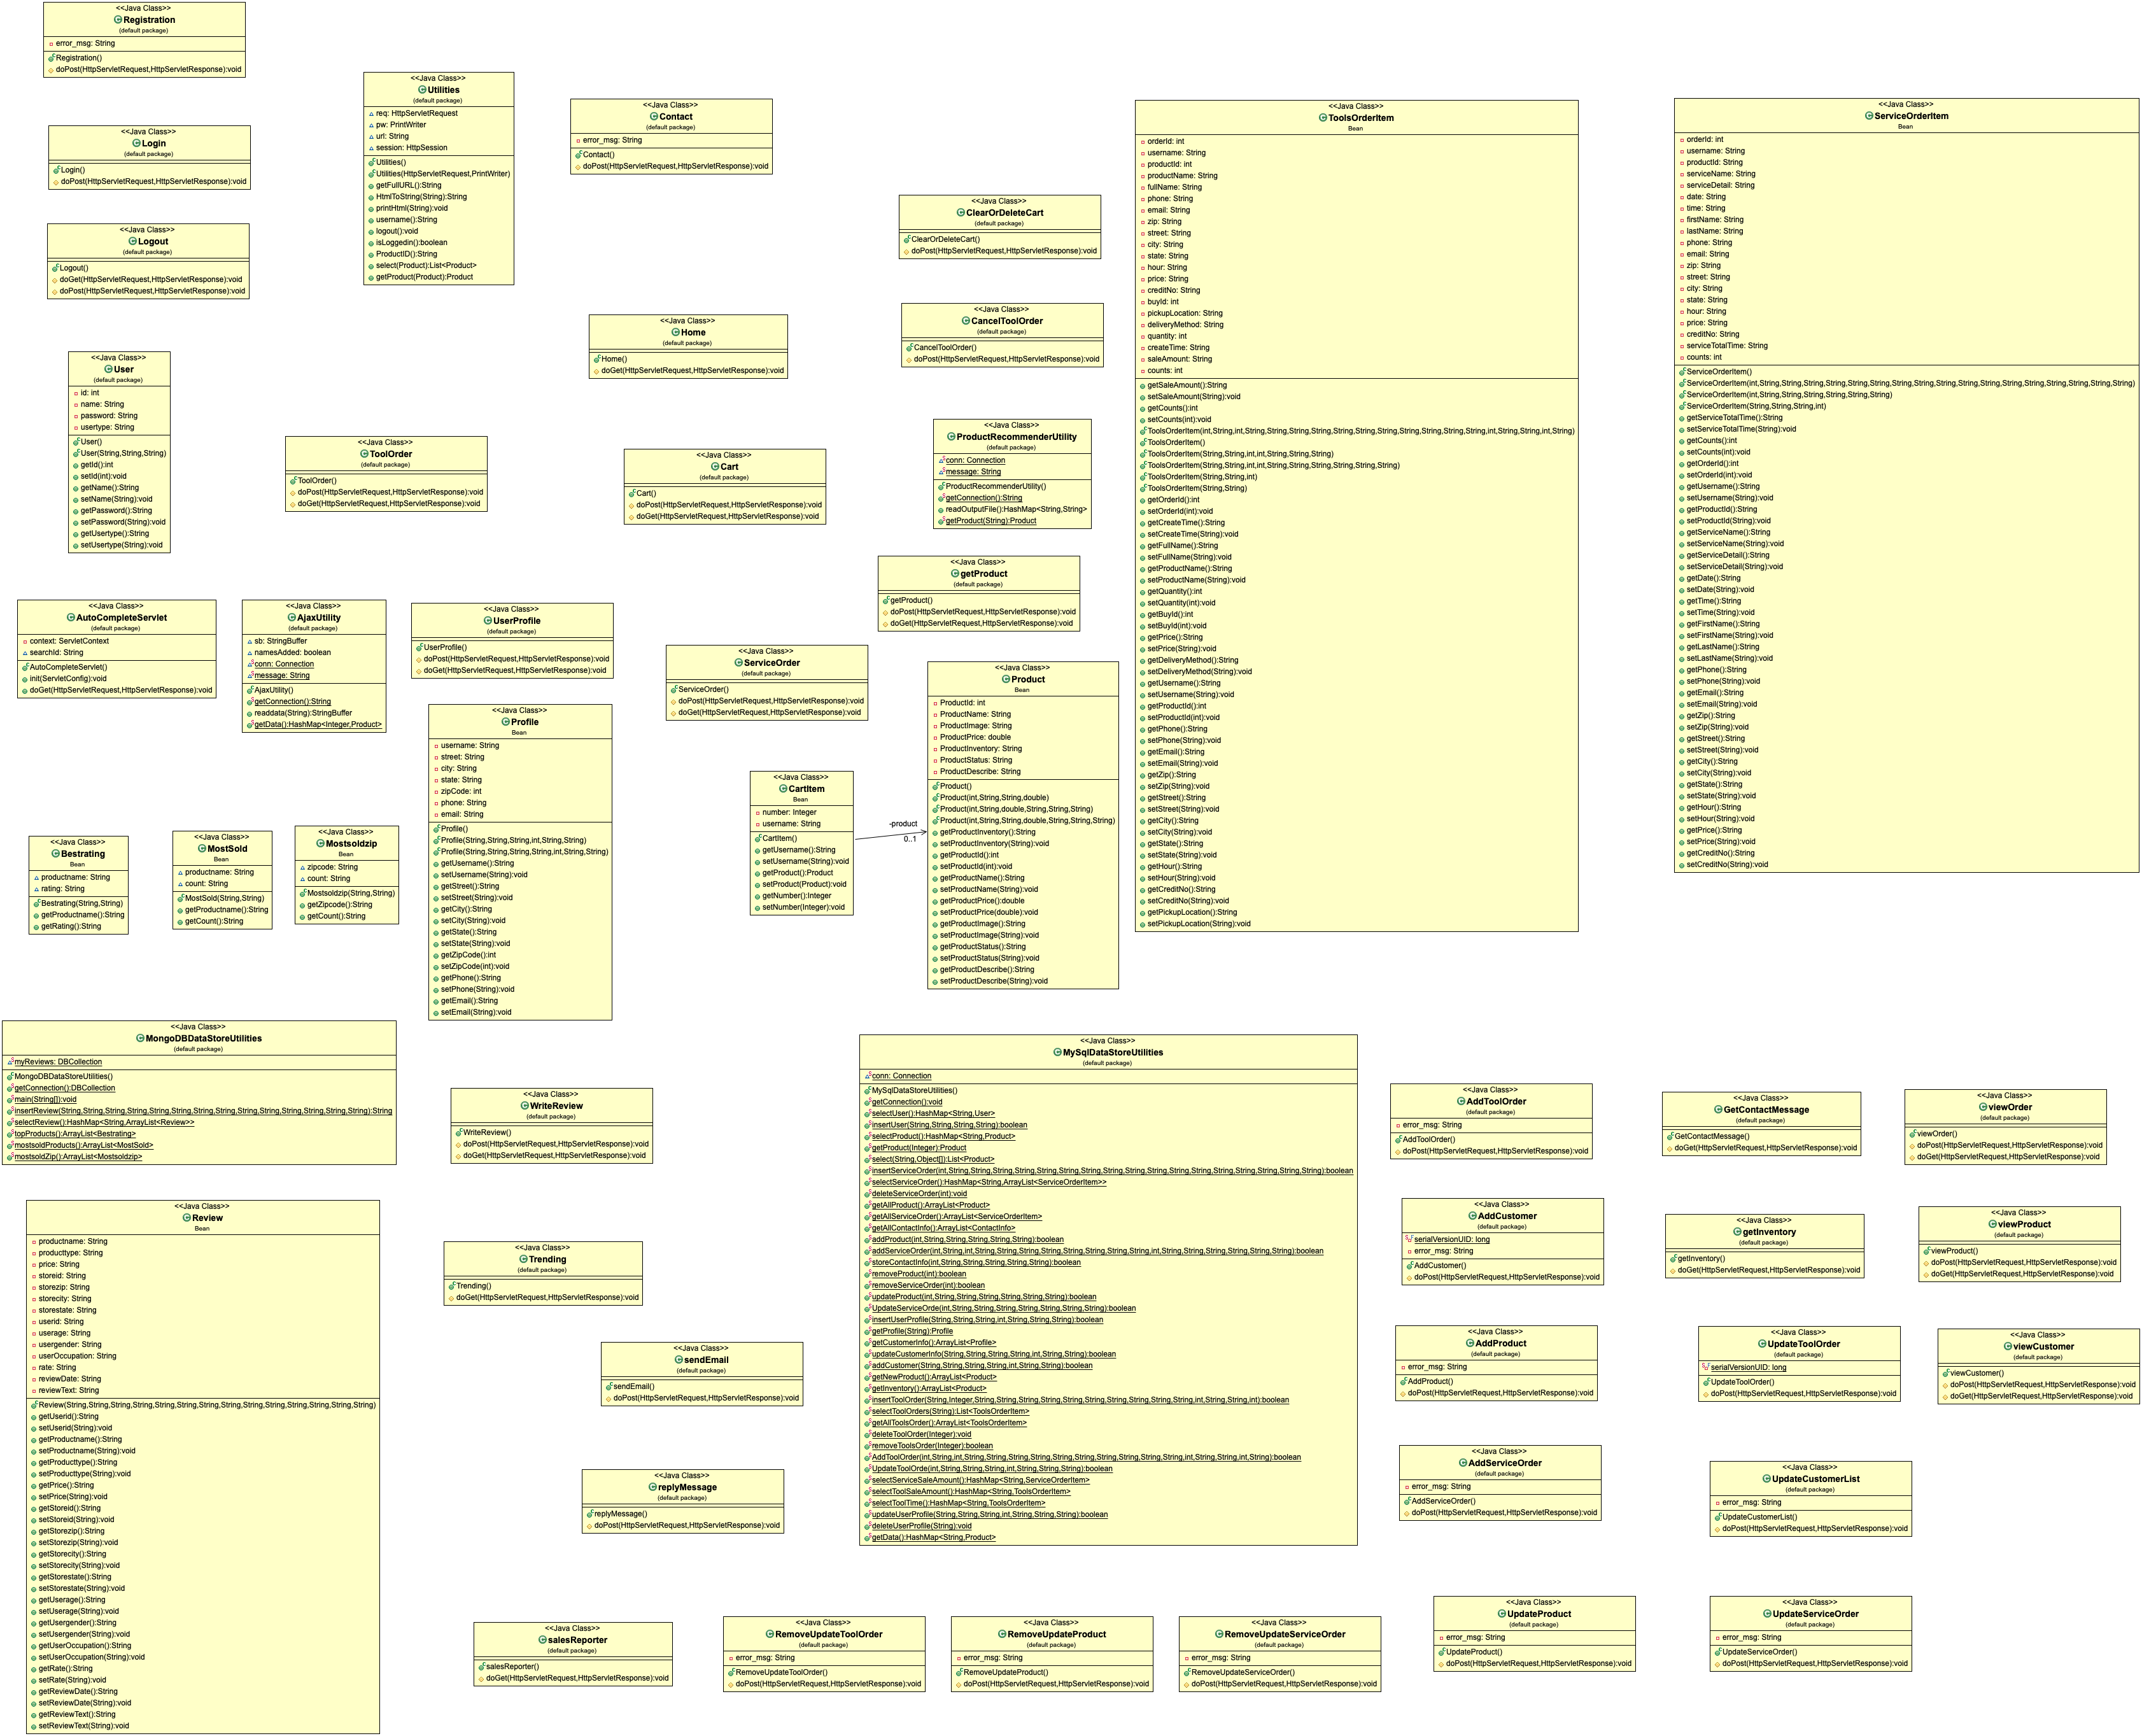
Class Diagram
Place your screenshot here

Slide 8

THANKS!
Any questions?
Demo following

